Slide 1
MAJOR PROJECT ON INTERNET BANKING
PREPARED BY:
MANISH PARUI
30901216085
KUSHANKUR DAS
30901216087
ADRITA MAJUMDER
30901216115
DEBYENDU GHOSH
30901216096
MASADUR RAHAMAN
30901216081
MANPREET SINGH
30901216083

Slide 2
Introduction
Online banking, also known as internet banking, is an electronic payment system that enables customers of a bank or other financial institution to conduct a range of financial transactions through the financial institution's website. The online banking system will typically connect to or be part of the core banking system operated by a bank and is in contrast to branch banking which was the traditional way customers accessed banking services.
Some banks operate as a "direct bank" (or “virtual bank”), where they rely completely on internet banking.
Internet banking software provides personal and corporate banking services offering features such as viewing account balances, obtaining statements, checking recent transaction and making payments. Access is usually through a secure web site using a username and password, but security is a key consideration in internet banking and many banks also offer two factor authentication using a security token.

Slide 3
Scope of the project
The present project has been developed to meet the aspirations indicated in the modern age. An attempt has been made through this project to do all work ease & fast. The purpose of the project is to build and application program to reduce the manual work for bankers in bank. It also provides features such as viewing account balances, obtaining statements, checking recent transaction and making payments.
It may help collecting perfect management in details. In a very short time, checking out details of one’s account will be obvious, simple and sensible. It will help a person to know and manage such as viewing account balances, obtaining statements, checking recent transaction and making payments.

Slide 4
COCOMO Estimation Method
We consider following cost drivers:
EAF = 1*1*1*1*1*1*1 = 1
Development Effort = 3.2 * (KLOC)^{1.05} * EAF
= 3.2 * 1.5^{1.05} * 1
= 4.9 PM (approx.)
Development time = 2.5 * (Effort)^{0.38}
= 4.6 months (approx.).
= 4 months 18 days (approx.).
Note: we consider our project as organic type. And we follow Intermediate COCOMO estimation method to calculate effort and development time.
Cost drivers | Ratting
Required software reliability | 1
Complexity of the product | 1
Required turnabout time | 1
Analyst capability | 1
Applications experience | 1
Programming language experience | 1
Use of software tools | 1
Total LOC = 1500
Then, KLOC = 1.5

Slide 5
Requirement Specification
Hardware Requirement:
Software Requirement:
Server side: -
Processor: x64, 1.4Ghz
Memory: 1GB
Drive space: 1GB
Client side: -
Processor: x32 or x64 1Ghz
Memory: 256MB
Drive space: 100MB
Server side: -
MySQL server
Tomcat Apache server
Java runtime environment
Client side: -
Web browser

Slide 6
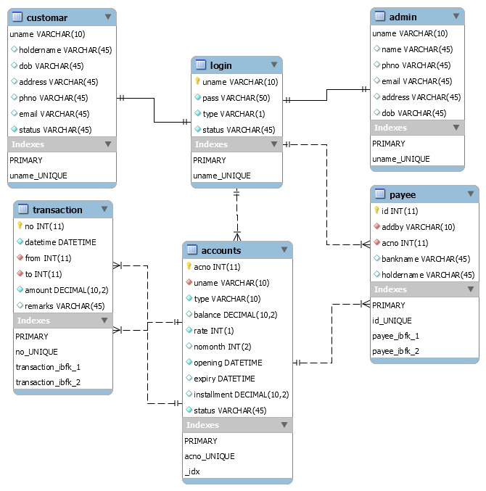
EERD

Slide 7
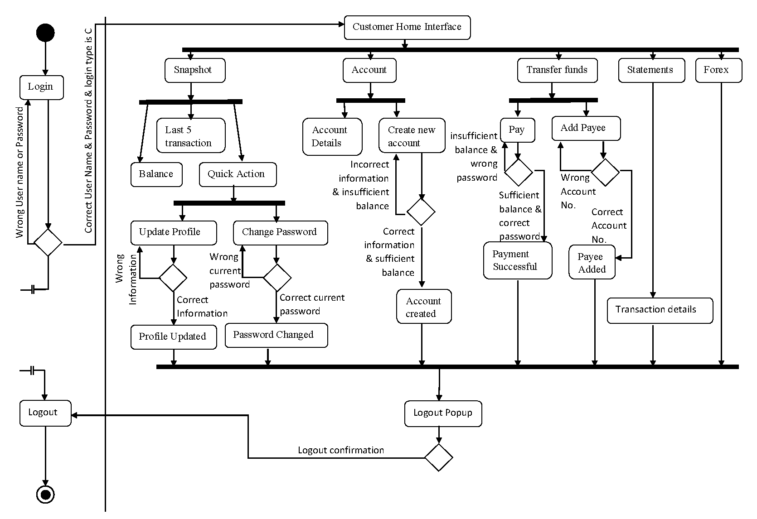
ACTIVITY DIAGRAM

Slide 8
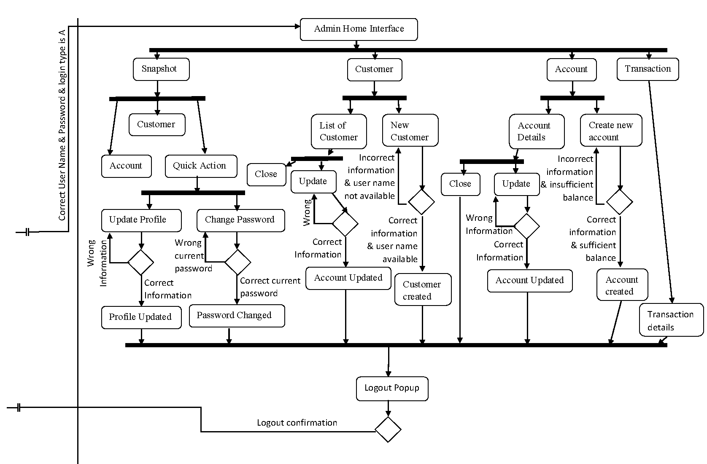
ACTIVITY DIAGRAM
Cont.

Slide 9
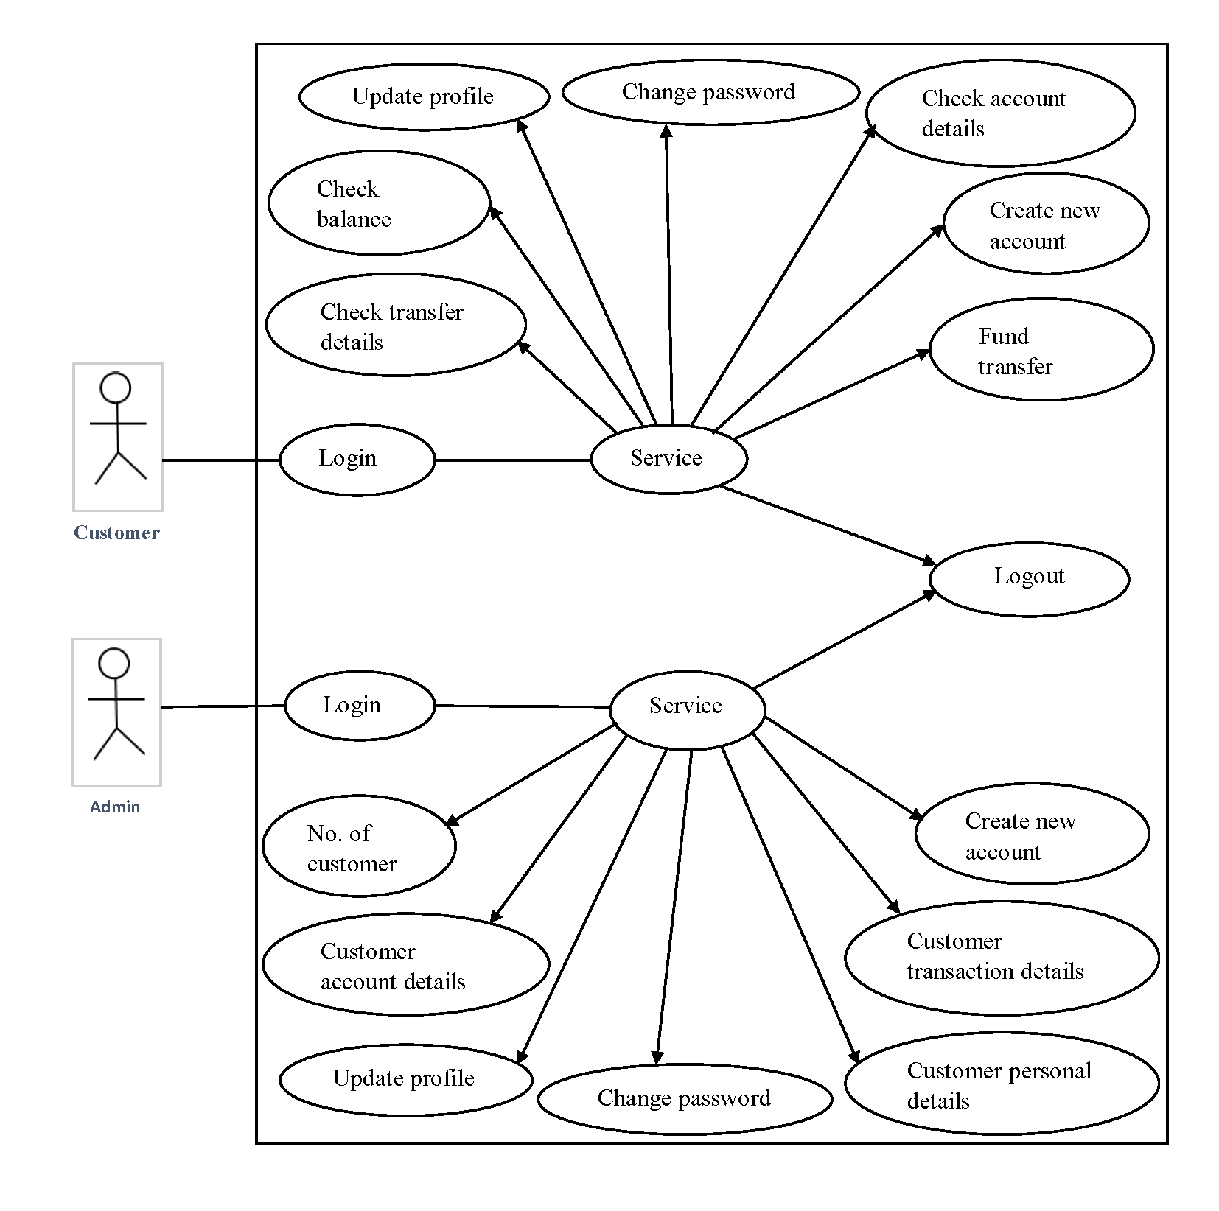
USE CASE

Slide 10
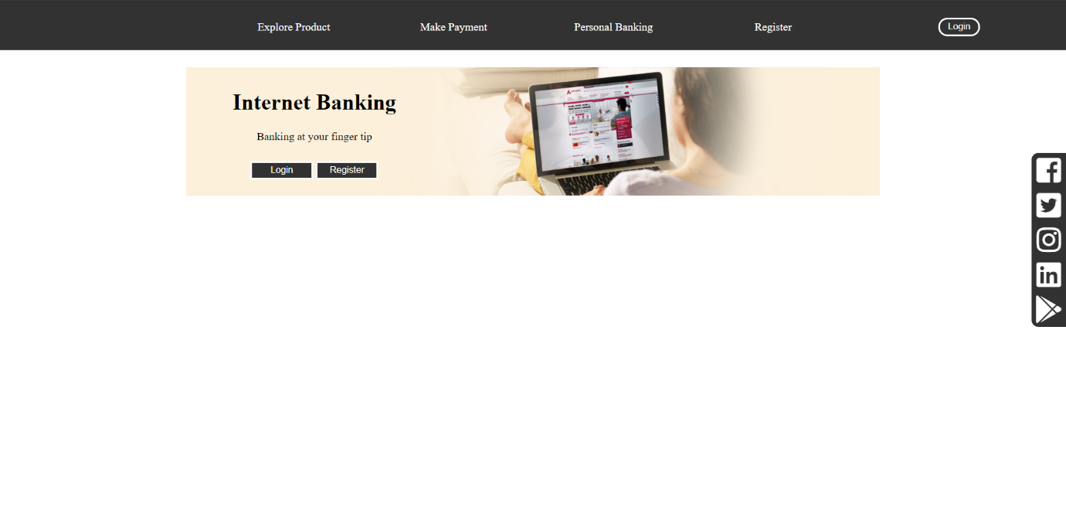
USER INTERFACE

Slide 11
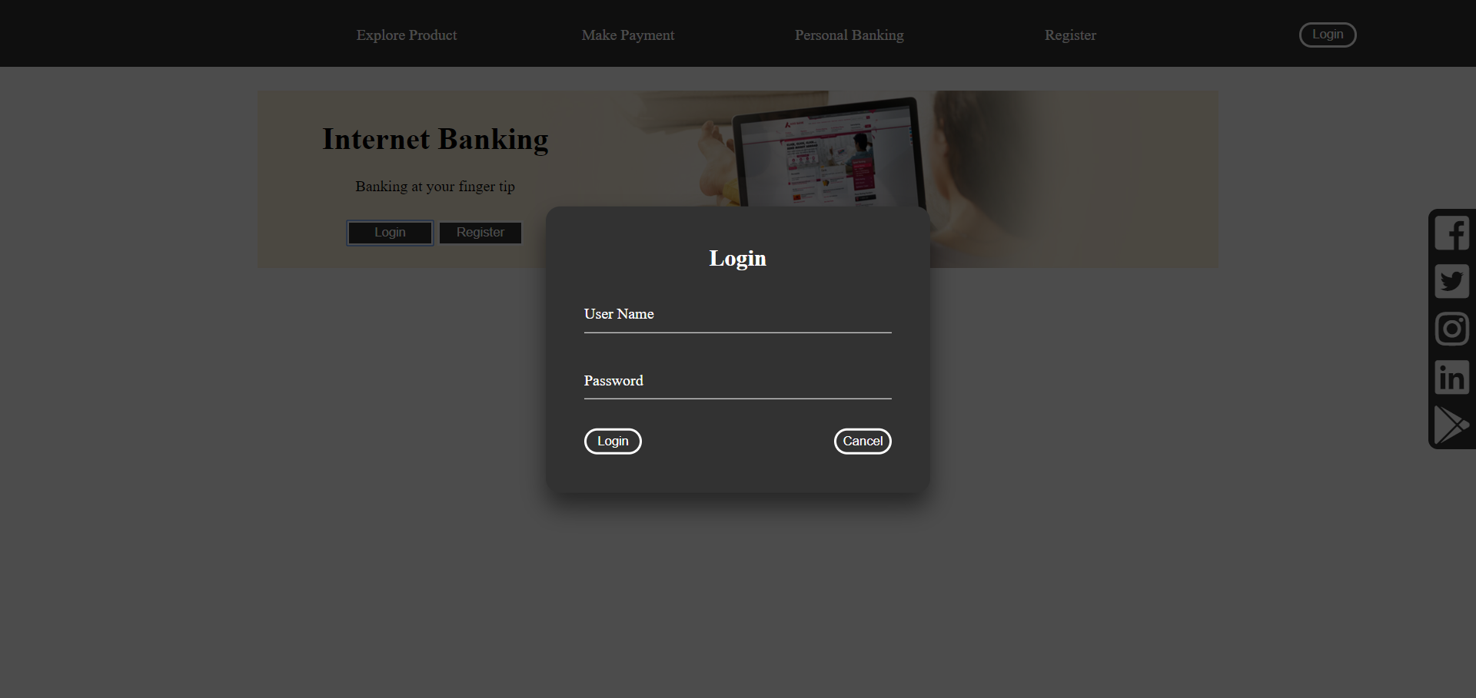

Slide 12
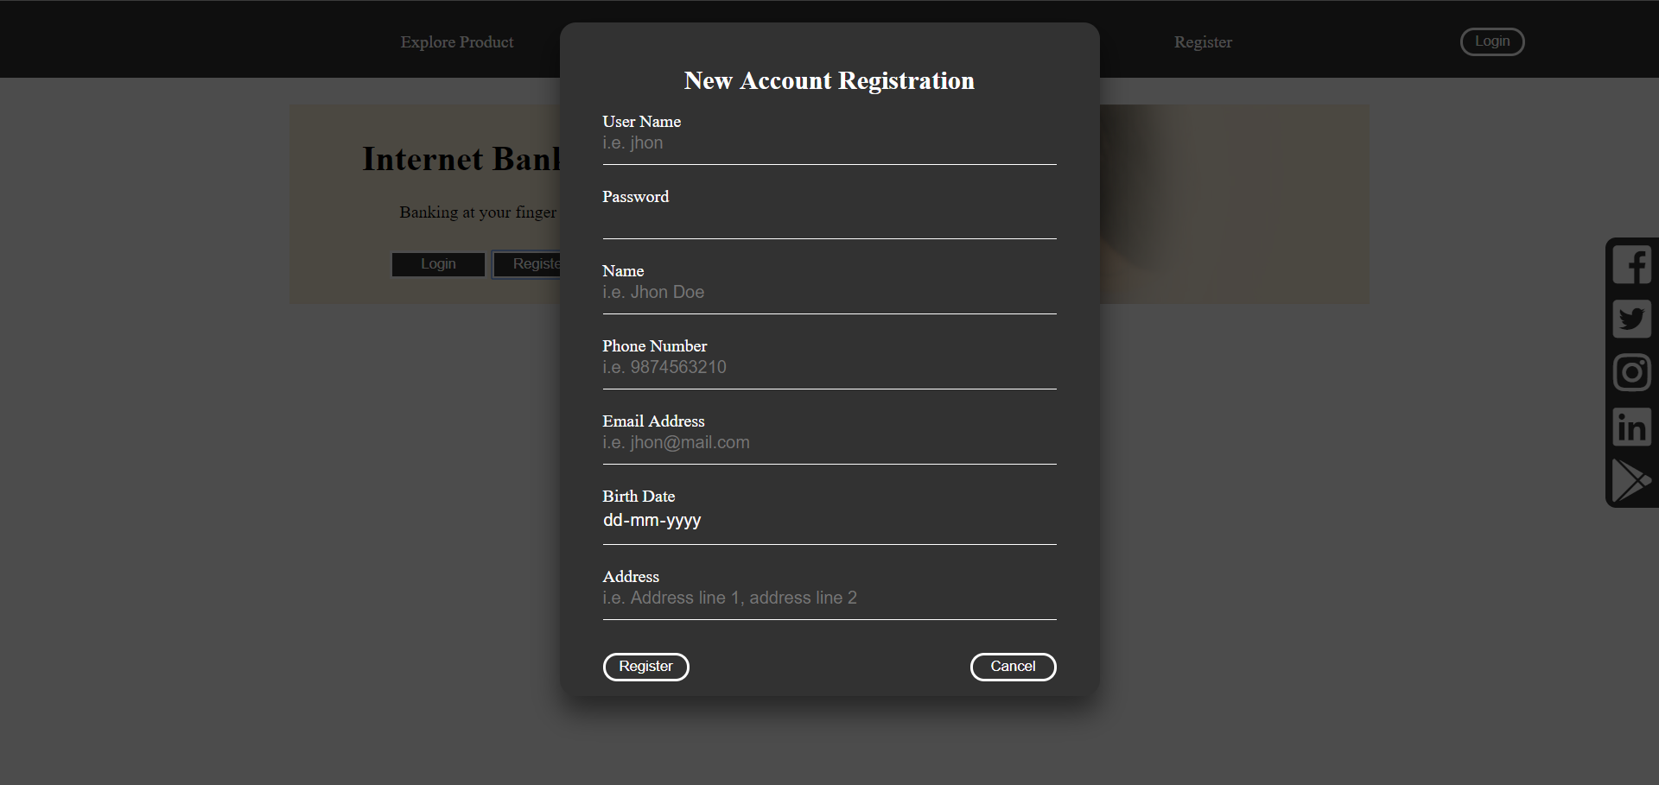

Slide 13
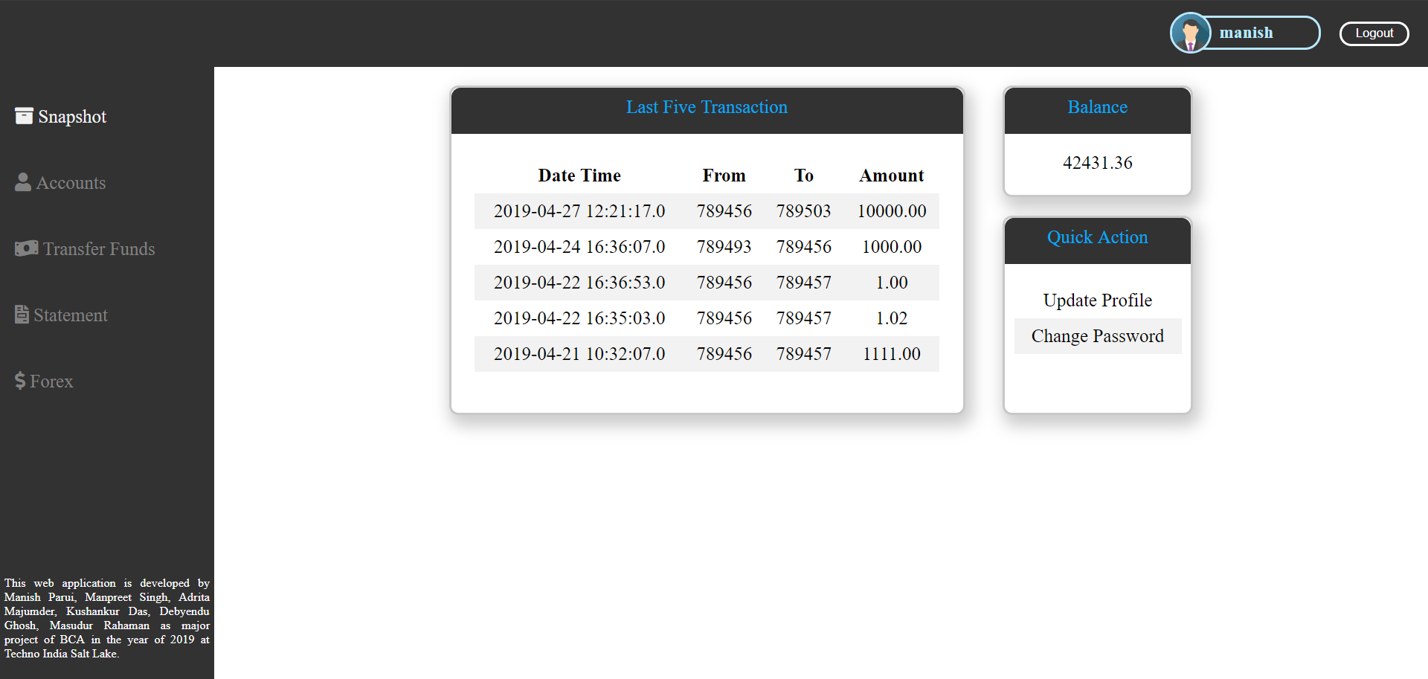

Slide 14
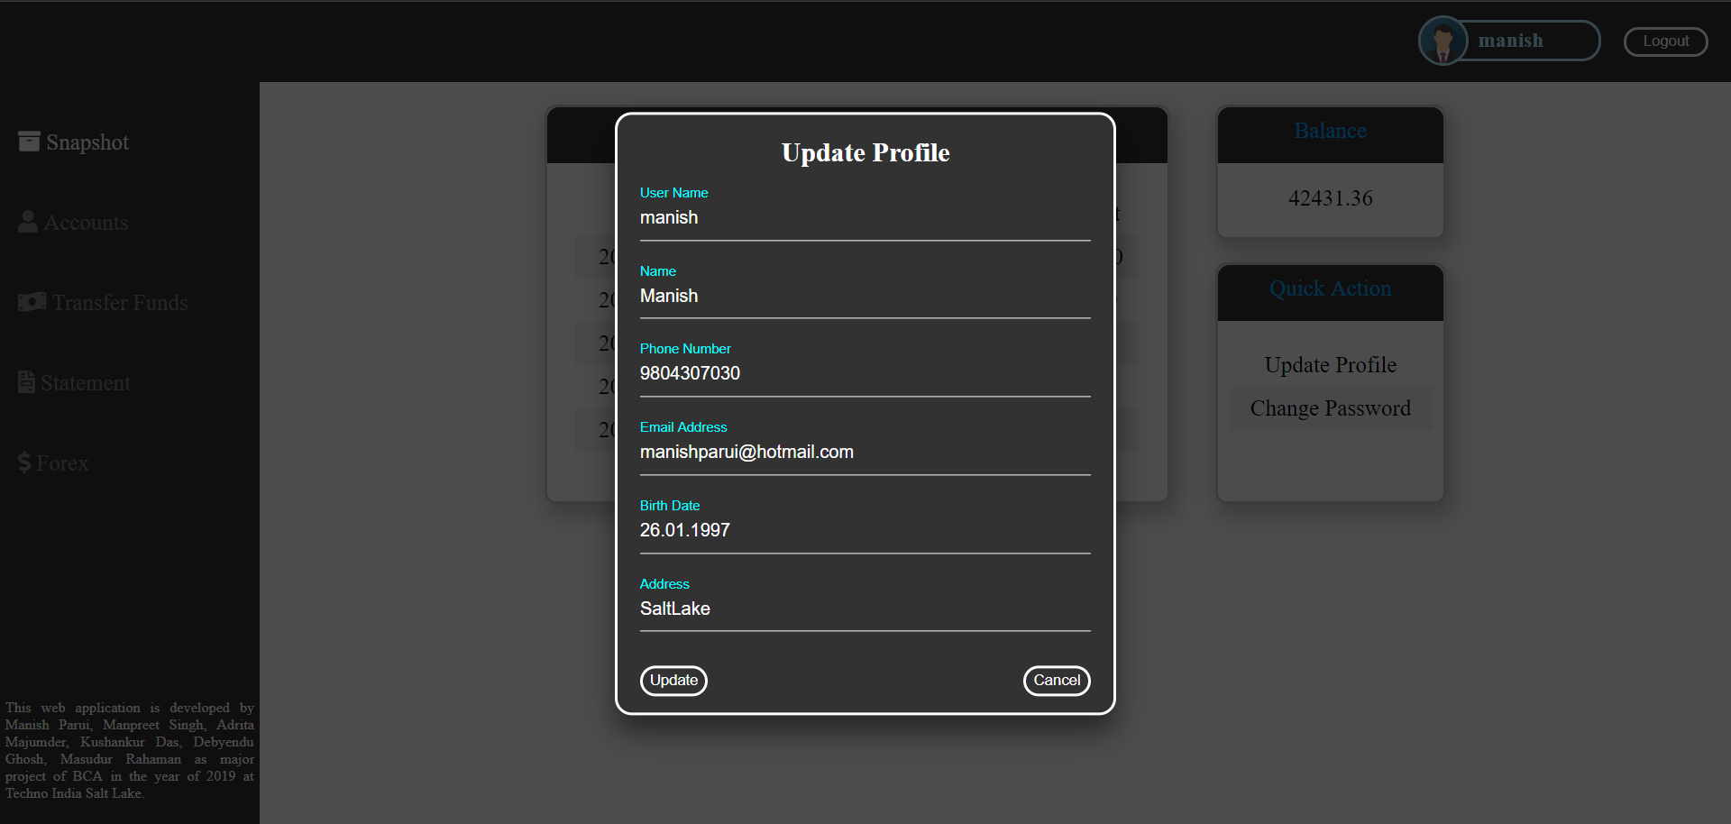

Slide 15
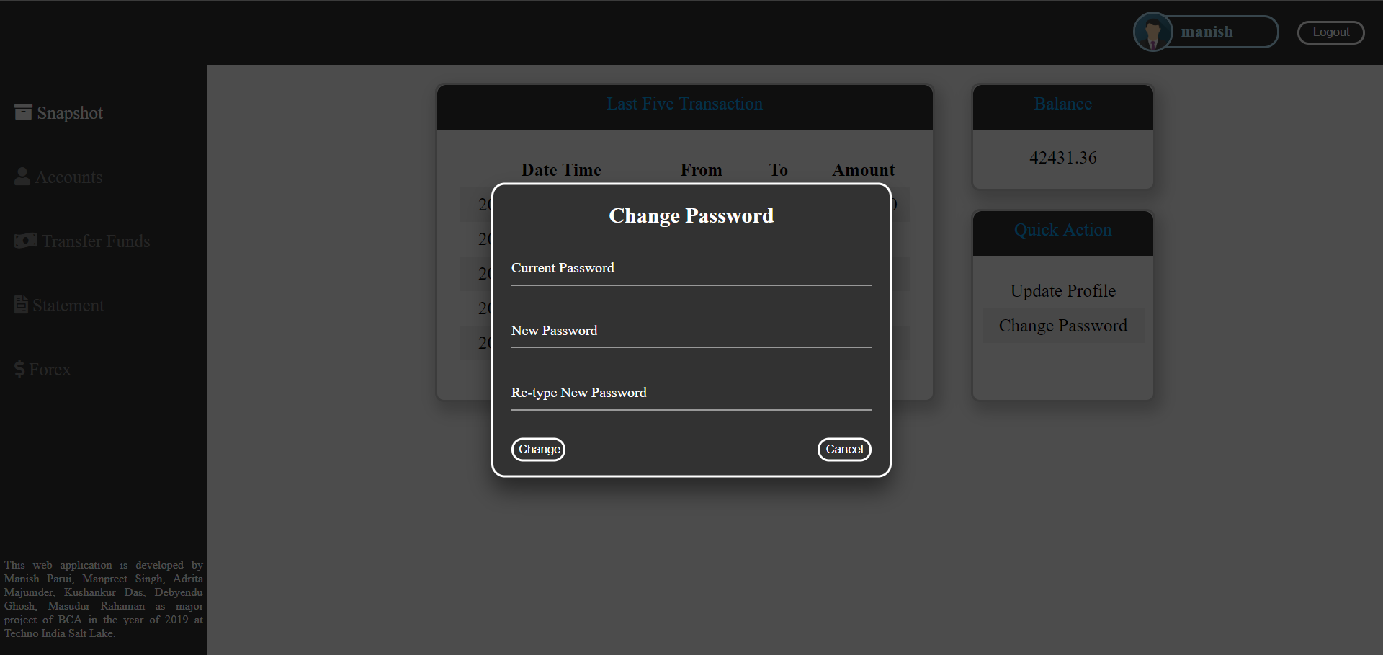

Slide 16
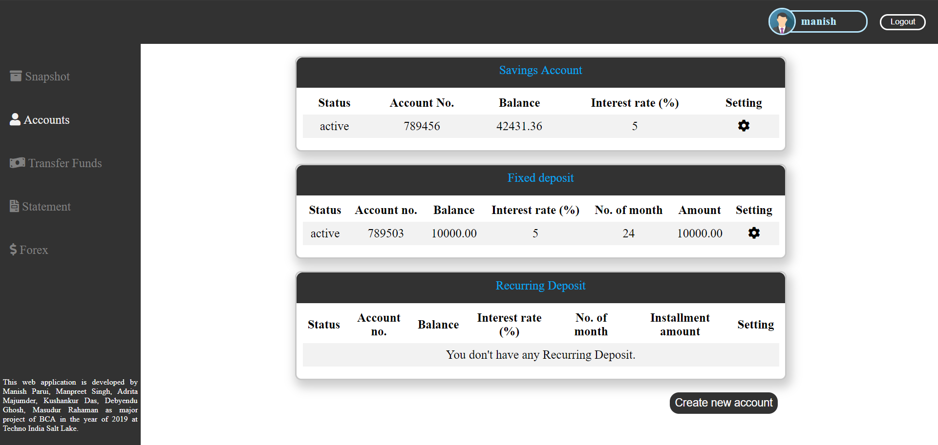

Slide 17
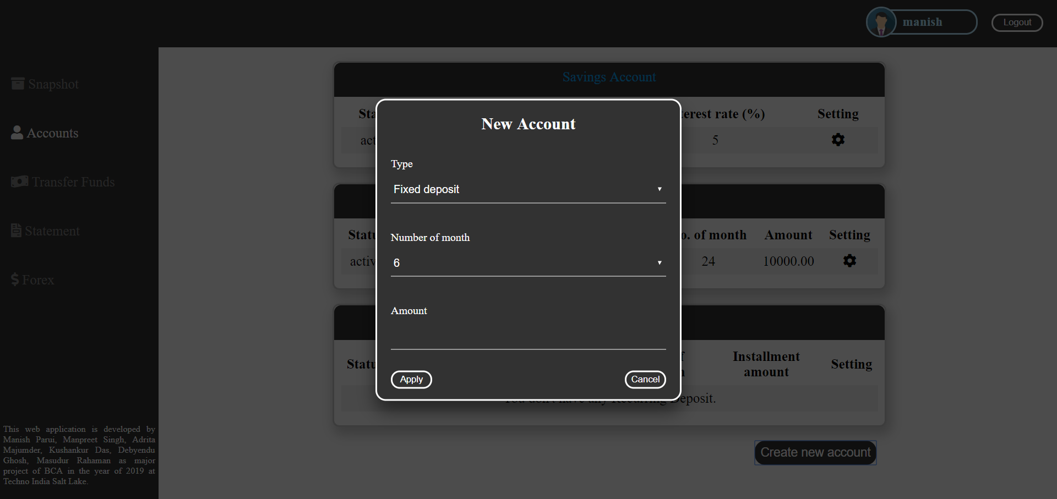

Slide 18
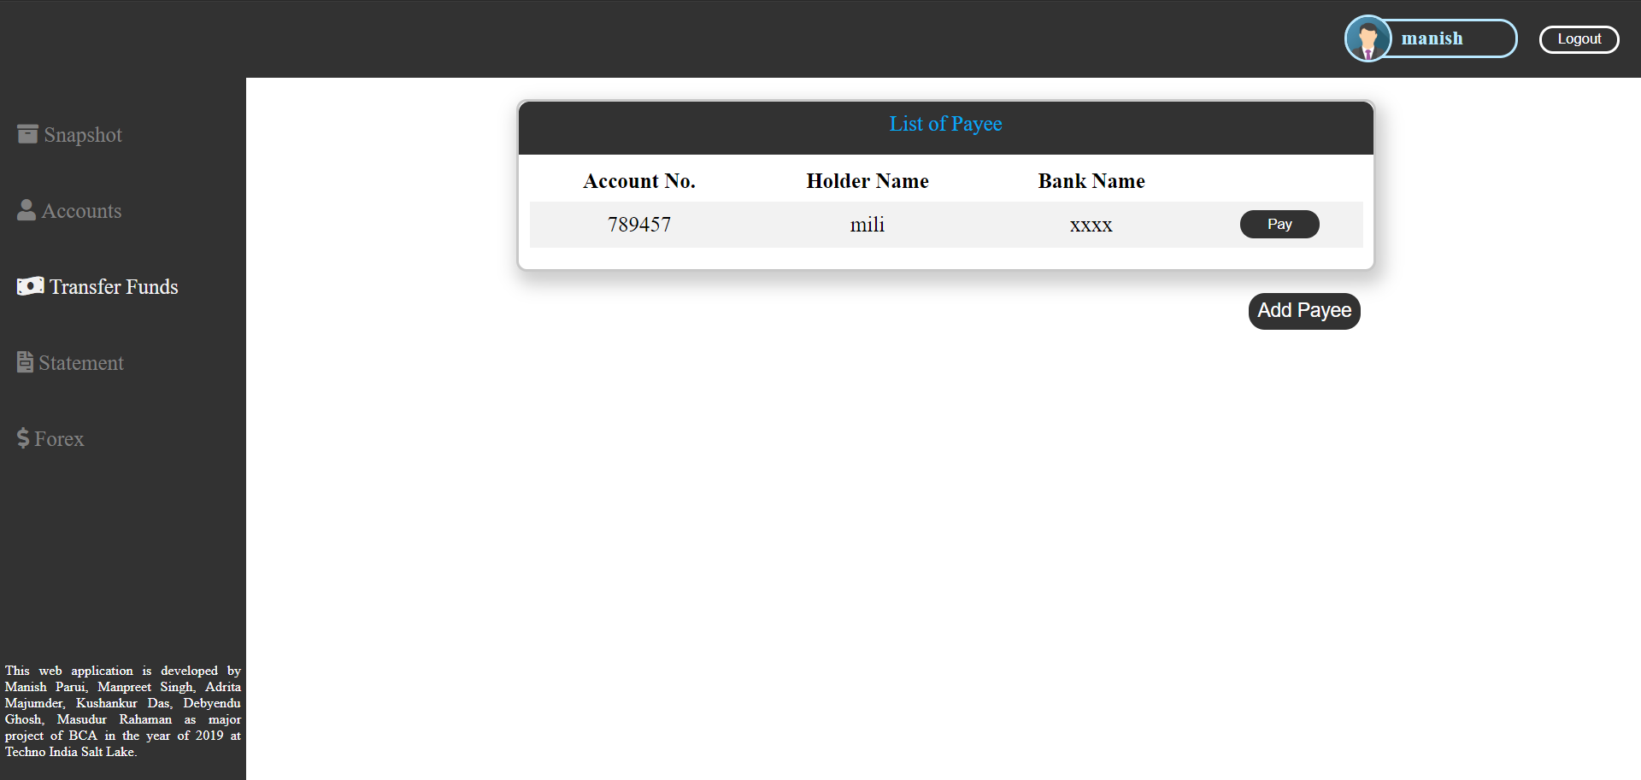

Slide 19
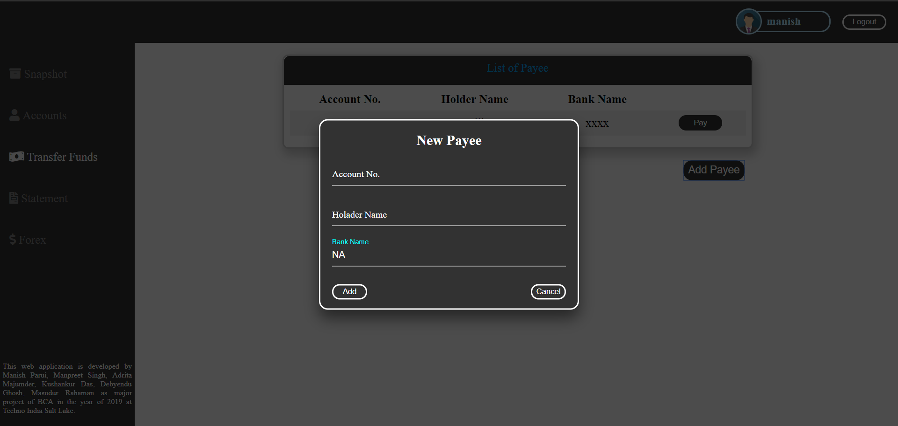

Slide 20
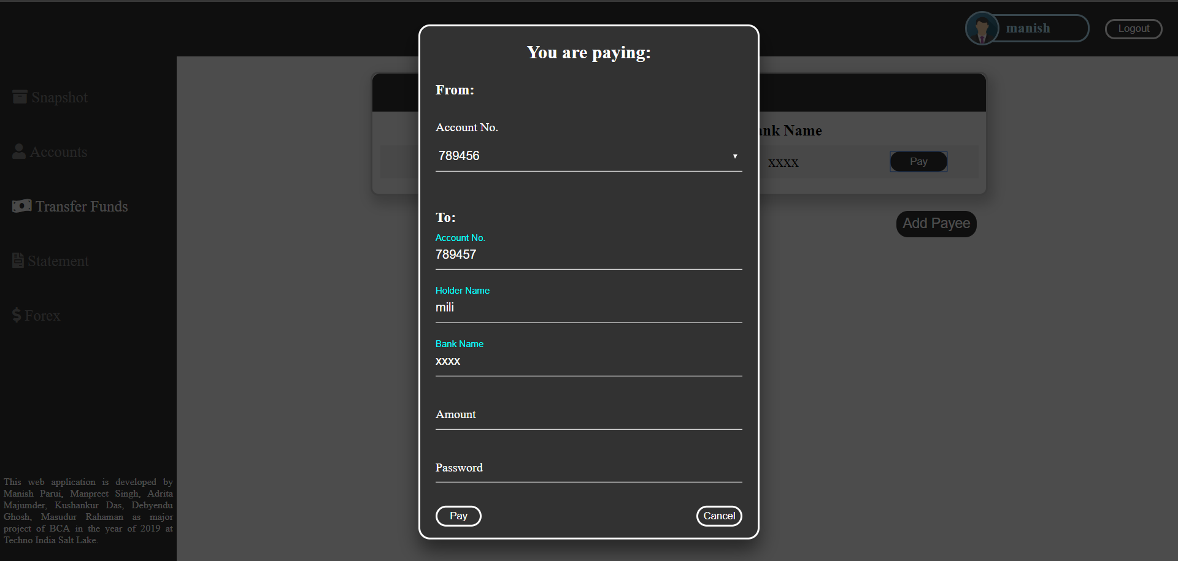

Slide 21
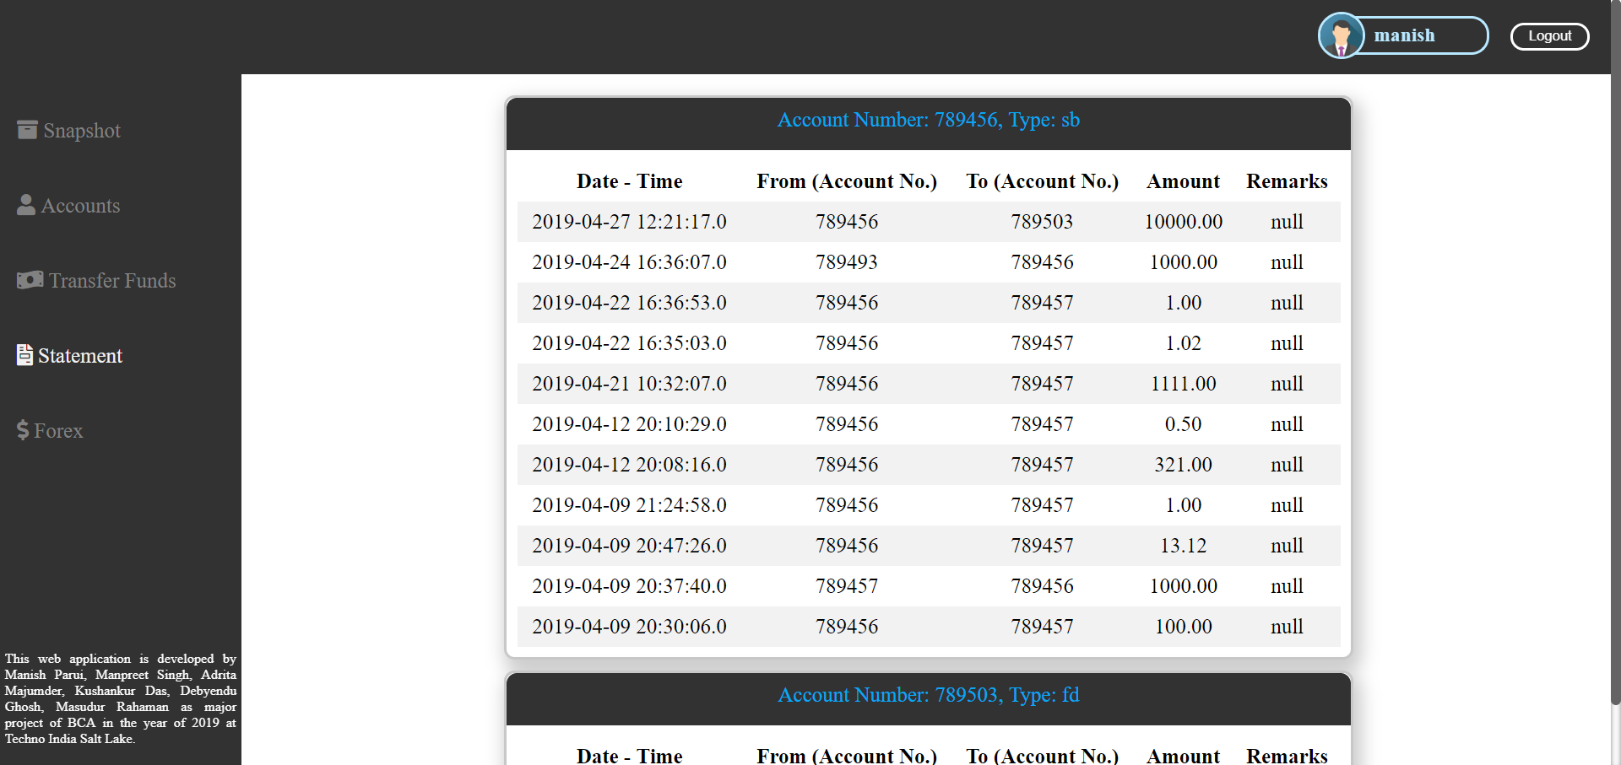

Slide 22
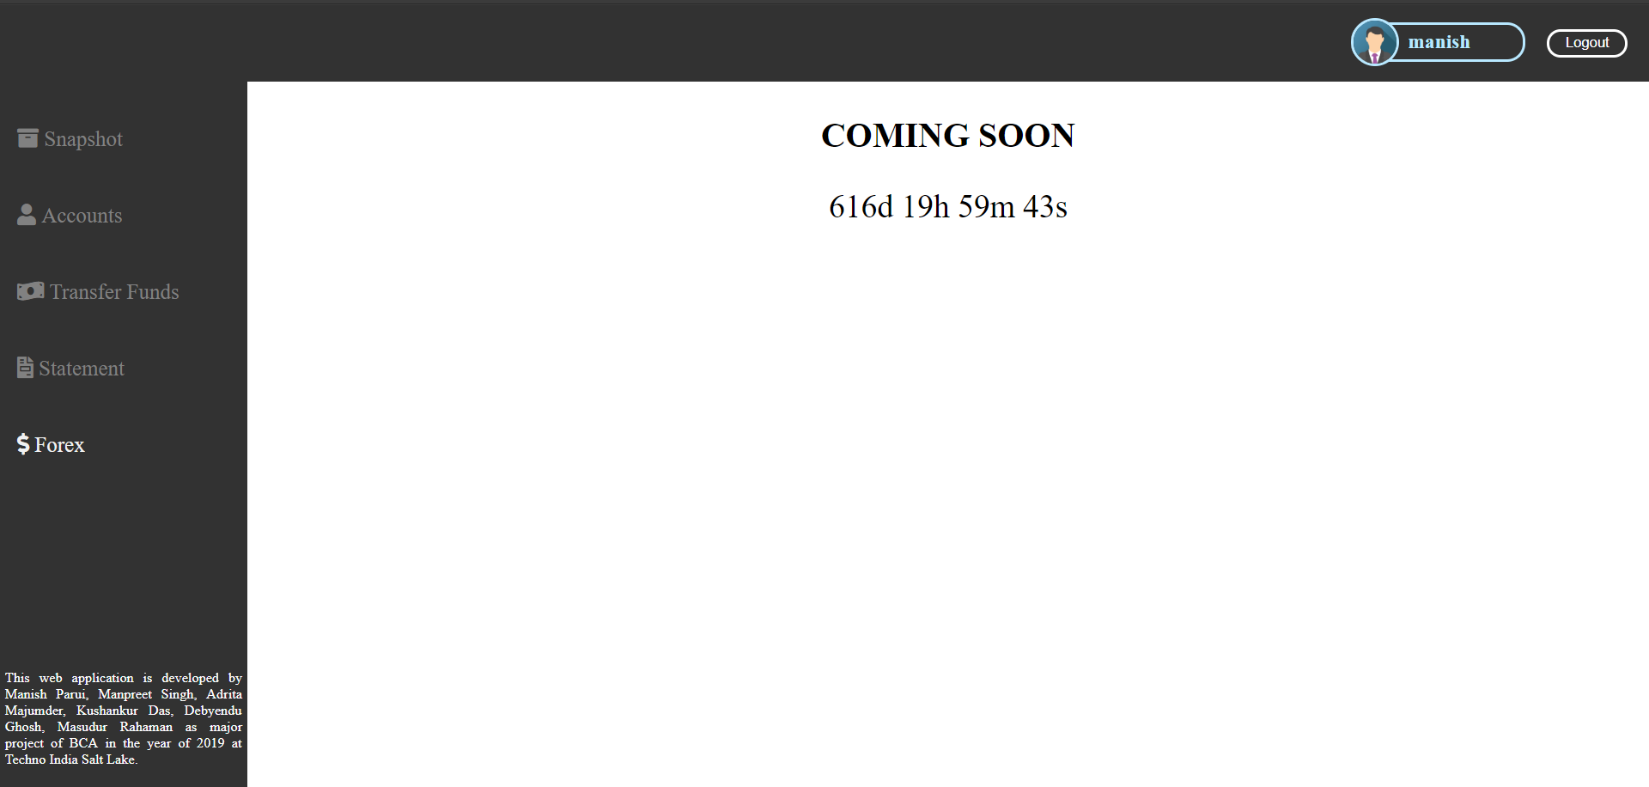

Slide 23
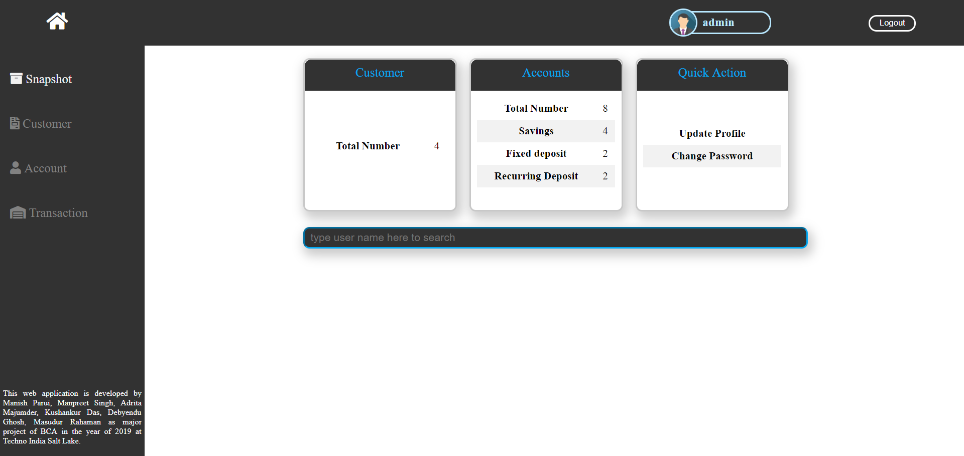

Slide 24
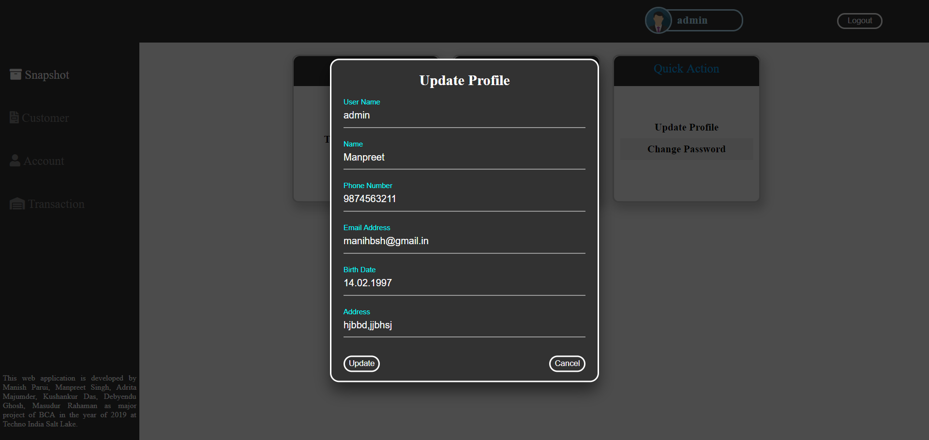

Slide 25
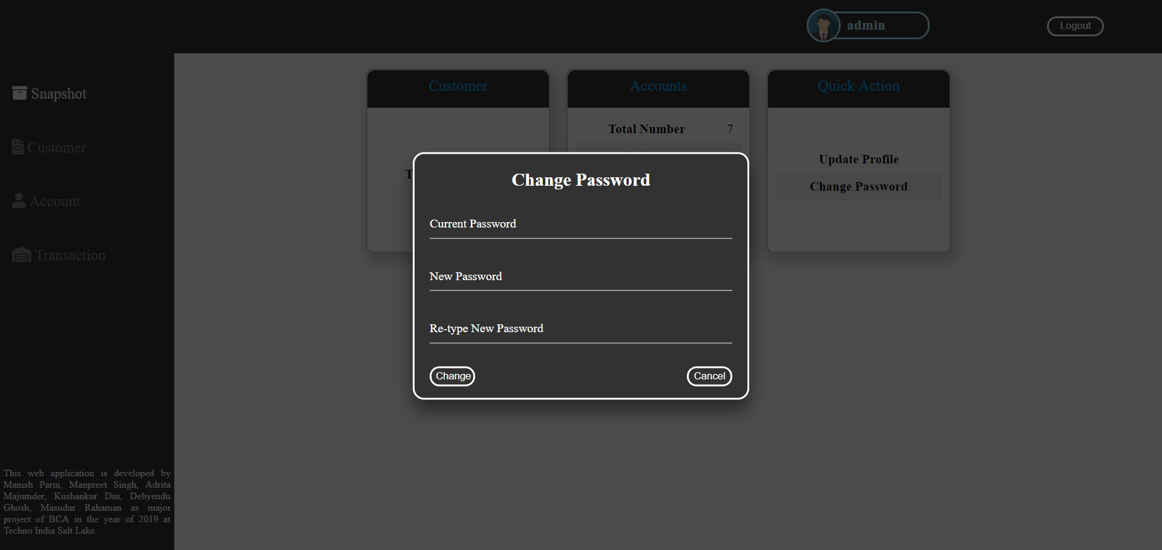

Slide 26
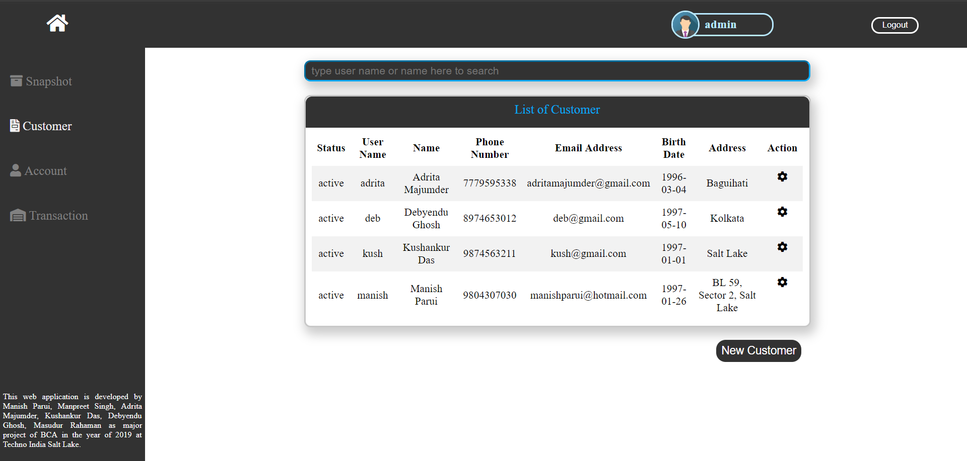

Slide 27
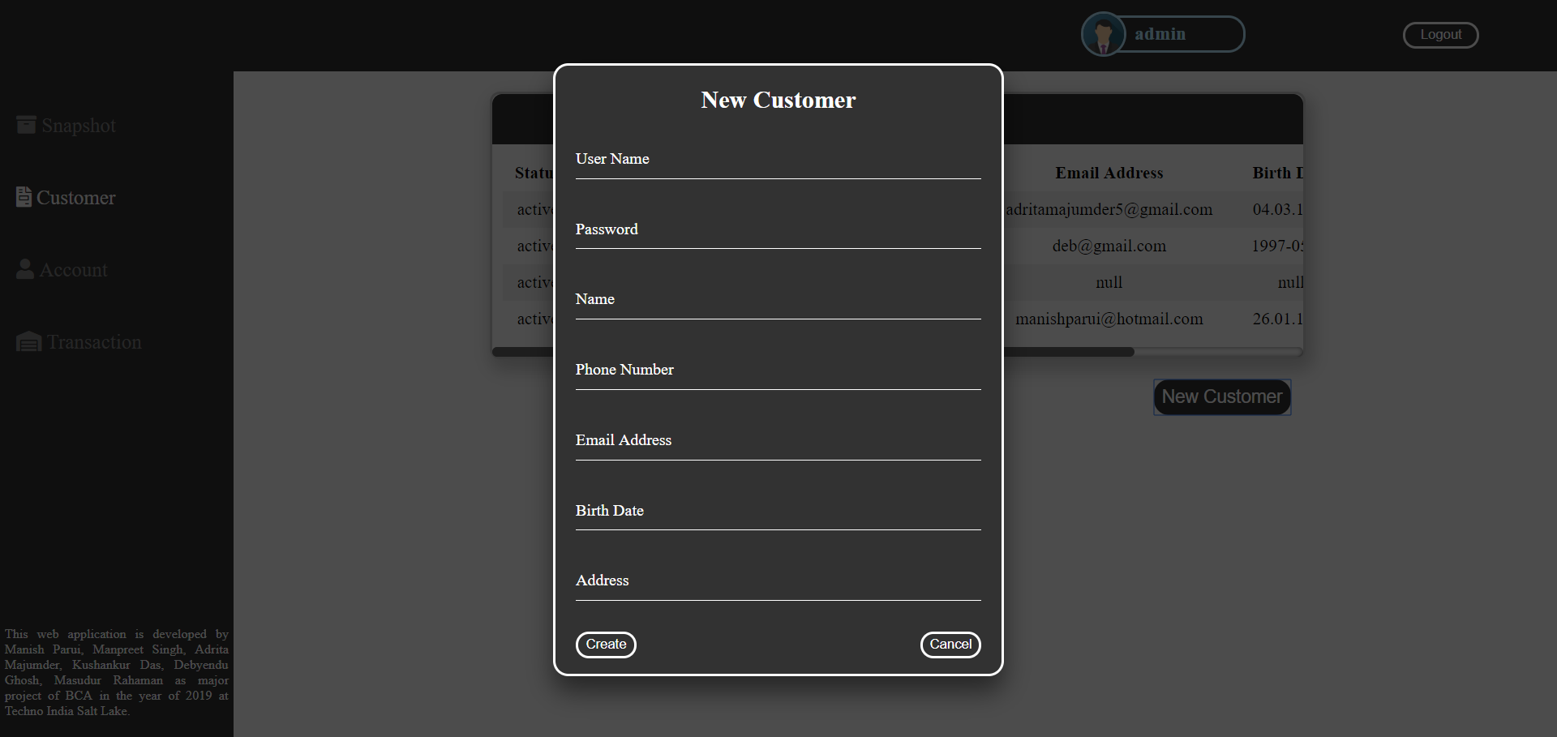

Slide 28
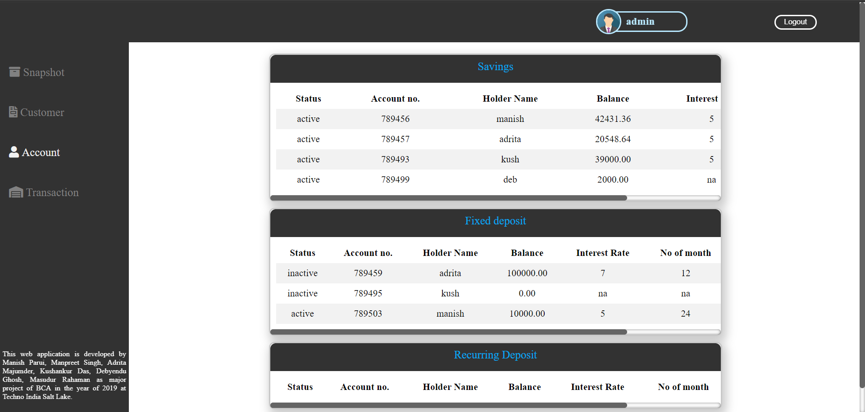

Slide 29
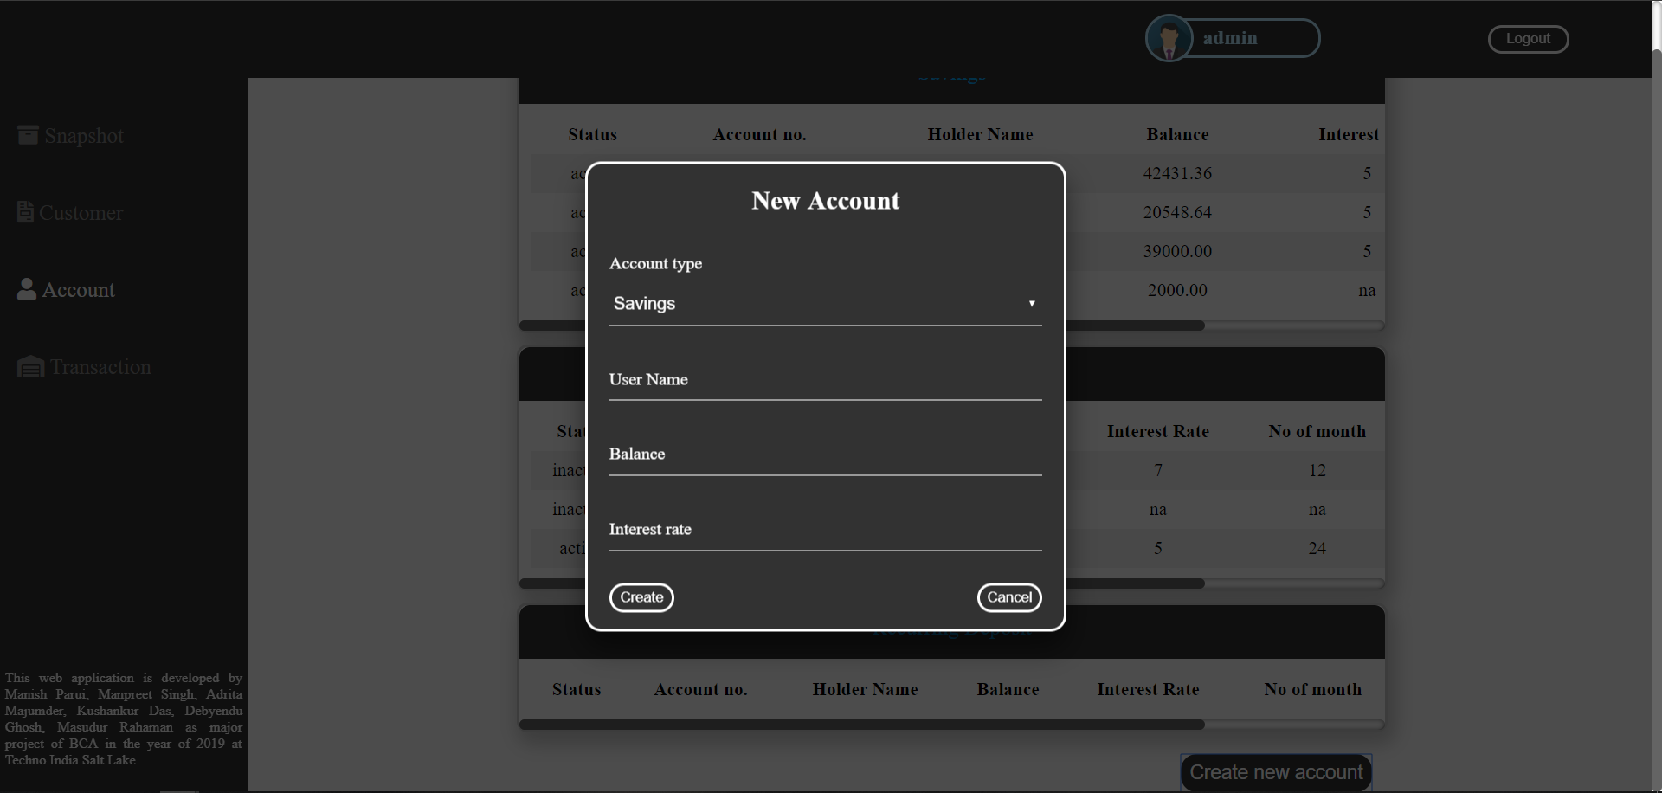

Slide 30
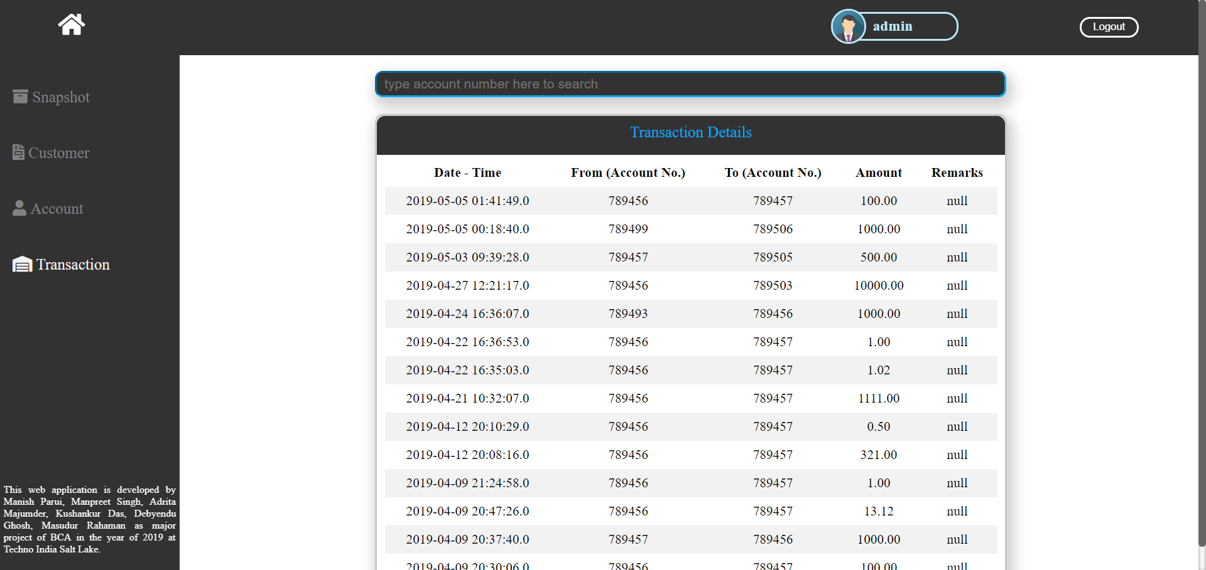

Slide 31
Testing
Module | Input | Output | Test Condition | Result
Login | Enter Login Id and Password | Logging into Customer or Admin Mode if Id or Password is correct or showing an error message: “Wrong Id or Password” | If the application able to verify the password from database if correct then redirect the page to home or admin-home according to account type else prevent user from login. | Passed
Register (CUSTOMER) | Enter Name, Phone Number, Address and other details to sign up for the banking as per procedure. | Account will be crated if each and every detail is given correctly and user name is available else an error message is displayed. | If the application able to check each and every details provided by the customer are correct in every aspect and user name is available else prevent user from register. | Passed
Snapshots (CUSTOMER) Update Profile Change Password | 1. Name, Phone Number, Email Address, Birth Date, Address. 2. Current Password, New Password. | 1. Profile is updated if given Phone Number, Email Address, Birth Date are correct then profile is updated else prevent user from updating. 2. Password is updated if the current password matches. | 1. If the application able to detect the error on specific fields like: Phone Number, Email address, Birth Date, or not 2. If the application able to update password while current password matched or not. | 1. Passed 2. Passed

Slide 32
Testing
Cont.
Module | Input | Output | Test Condition | Result
Accounts (CUSTOMER) Close account Create New account | 1. No Input required 2. Account type, Number of Month, Amount | 1. Account is closed except Saving account. 2. Account created if customer’s saving account have sufficient balance else prevent customer from creating one. | 1. If the application able to close the account except saving account. 2. If the application able to create new account if there are sufficient balance on customer saving account. | 1. Passed 2. Passed
Transfer Fund (CUSTOMER) Pay Add Payee | 1. Amount, Password. 2. Account number, holder name. | 1. Customer can able to transfer fund if they have sufficient balance on their saving account and password is correct. 2. Payee added if the account number is correct. | 1. If the application able to transfer fund if there are sufficient balance on customer’s saving account and password is correct else prevent user from transfer fund. 2. If the application able to add payee or not | 1. Passed 2. Passed

Slide 33
Testing
Cont.
Module | Input | Output | Test Condition | Result
Snapshots (ADMIN) Update Profile Change password | 1. Name, Phone Number, Email Address, Birth Date, Address. 2. Current Password, New Password. | 1. Profile is updated if given Phone Number, Email Address, Birth Date are correct then profile is updated else prevent user from updating. 2. Password is updated if the current password matches. | 1. If the application able to detect the error on specific fields like: Phone Number, Email address, Birth Date, or not 2. If the application able to update password while current password matched or not. | 1. Passed 2. Passed
Customer (ADMIN) New customer profile creation | User name, Password, Name, Phone Number, Email Address, Birth Date, Address. | New user profile is created if the user name entered by the user is not hold by anyone else, else prevent user from creating user profile. | If the application is able to create new customer profile or prevent user from create new customer profile or not. | Passed
Accounts (ADMIN) New Account creation | Account type, User name, Balance (only for savings), Interest rate, Amount (only for Fixed and recurring deposit), No of Month (only for Fixed and recurring deposit). | Account created if details which are provided by user are correct else prevent user from creating account. | If the application is able to create new account or prevent user from create new account or not. | Passed

Slide 34
FUTURE SCOPE OF THE PROJECT
The followings are just a sample of future opportunities that could be implemented:
This project can be updated in future to provide loan features.
Virtual cards services can be implemented in future.
This project can be updated in future to provide bills payment functionality.
Changing of password can be done using user phone number or email address.
We can implement 2-factor authentication for login which can bring more security.
We can include real-time time chat services to improve user experience and fix their problem instantly.
This project can be updated in future to provide multi-currency transaction.

Slide 35
Conclusion
Banking systems have been with us for as long as people have been using money. Banks and other financial institutions provide security for individuals, businesses and governments, alike.
In general, what banks do is pretty easy to figure out. For the average person banks accept deposits, make loans, provide a safe place for money and valuables, and act as payment agents between merchants and banks.
Banks are quite important to the economy and are involved in such economic activities as issuing money, settling payments, credit intermediation, maturity transformation and money creation in the form of fractional reserve banking.
Now whereas in point of online banking system it is an electronic payment system that gives flexibility to many users. It also reduces work stress of a banker. Internet banking software provides personal and corporate banking services offering features such as viewing account balances, obtaining statements, checking recent transaction and making payments. Access is usually through a secure web site using a username and password, but security is a key consideration in internet banking and many banks also offer two factor authentication using a username and password feature.

Slide 36
References
https://www.w3schools.com/html/default.asp
https://www.w3schools.com/css/default.asp
https://www.w3schools.com/js/default.asp
https://www.javatpoint.com/java-tutorial
https://www.tutorialspoint.com/html_online_training/index.ap
https://www.tutorialspoint.com/css_online_training/index.asp
https://en.wikipedia.org/wiki/Cascading_Style_Sheets

Slide 37
THANK YOU
A presentation by Manish Parui, Kushankur Das, Adrita Majumder, Debyendu Ghosh, Masudur Rahaman, Manpreet Singh
Techno India Salt Lake, Department of BCA

